Slide 1
Masked Autoencoders Are Scalable Vision Learners
2021
鄧仲恩
NTUST GAMELab
Notes:
Masked Autoencoders 是一個可拓展的視覺學習技術

Slide 2
Outline
Introduction
Related Work
Approach
ImageNet Experiments
Transfer Learning Experiments
Discussion and Conclusion
NTUST GAMELab

Slide 3
Introduction
NTUST GAMELab

Slide 4
Introduction
Deep learning can easily overfit million of images but label image is usually private.
NLP solve this problem by self-supervised pretraining. The solutions based on GPT and BERT.
NTUST GAMELab
Notes:
1. labeled images不好取得
2. conceptually simple: they remove a portion of the data and learn to predict the removed content. These methods now enable training of generalizable NLP models containing over one hundred billion parameters.

Slide 5
Introduction
Autoencoder is success in BERT, but progress in vision lags behind NLP. what makes masked autoencoding different between vision and language?
Convolutions operate on regular grids and it is not easily put mask tokens(BERT) or positional embeddings.
Languages are highly semantic and information-dense. Images with heavy spatial redundancy.
In vision, autoencoder’s decode is a low semantic information. In language, decoder predicts missing words contain rich semantic information.
NTUST GAMELab
Notes:
但是BERT在拓展是視覺上卻是落後的
1.卷機就是一個常規的網格運算 這很難放mask tokens 或 位置編碼進去 ->Vit解決了這個問題
2.去除幾個單詞即會造成理解上的困難 -> 去除高比例的圖像區塊 強制模型學習較遠距離塊間的關係
3. vision->conv inverse language->MLP

Slide 6
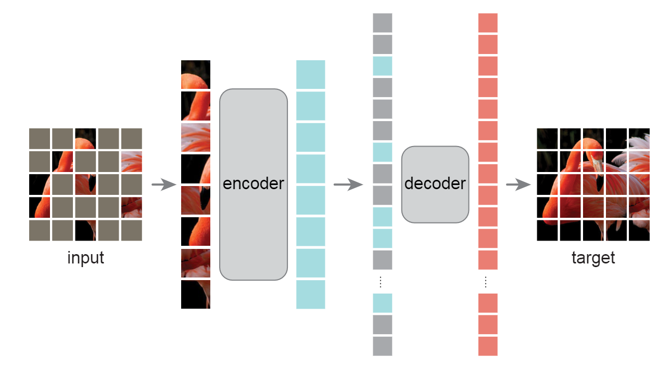
Introduction - masked autoencoder (MAE)
With MAE pre-training, ViT-H achieve 87.8% when finetuned on ImageNet-1K.
Transfer learning on other vision tasks achieves better results than its supervised pretrain.
NTUST GAMELab

Slide 7
Related Work
NTUST GAMELab

Slide 8
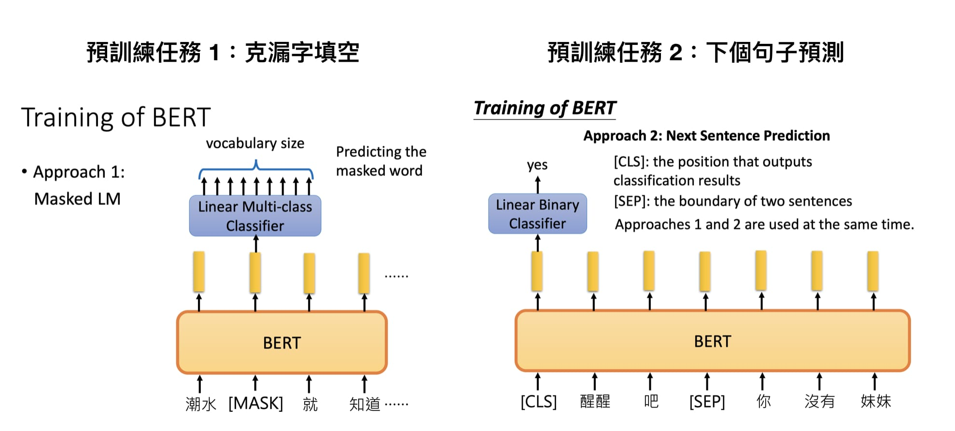
Related Work - Masked language modeling
BERT and GPT are highly successful methods for pre-training in NLP.
These methods hold out a portion of the input sequence and train models to predict the missing content.
NTUST GAMELab
Notes:
2.如圖

Slide 9
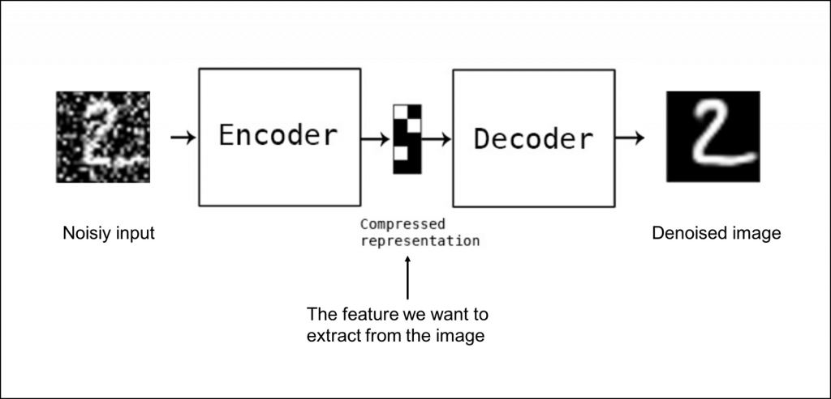
Related Work - Autoencoding
Denoising autoencoders
NTUST GAMELab
Notes:
MAE is a form of denoising autoencoding

Slide 10
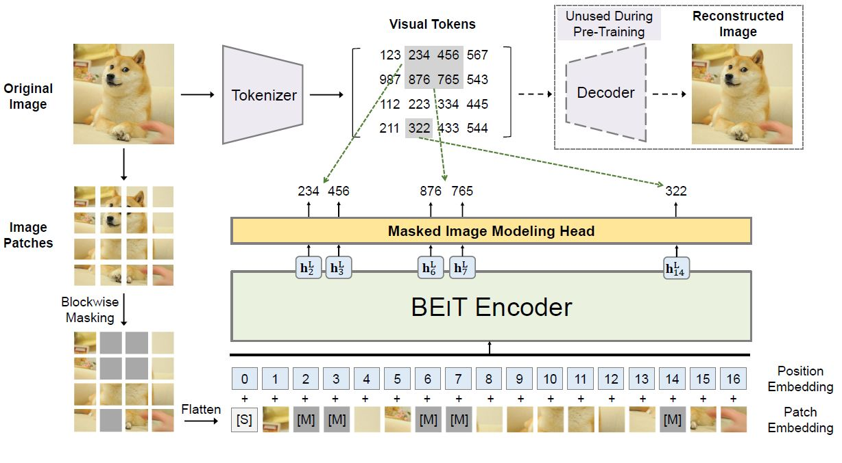
Related Work - Masked image encoding
iGPT
ViT
BEiT
NTUST GAMELab
Notes:
iGPT 線性探測的方式
ViT 嘗試了自監督學習的方式 但結果不盡人意
BEiT則是提出 predict discrete tokens作為預訓練

Slide 11
Approach
NTUST GAMELab

Slide 12
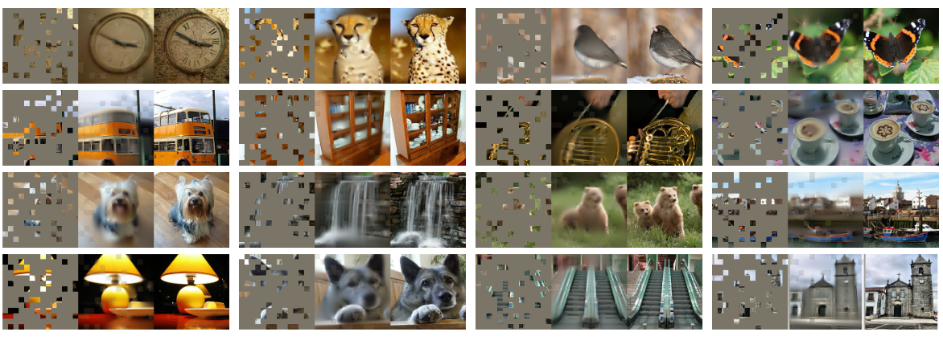
Approach - Masking
non-overlapping patches
Random sampling
NTUST GAMELab
Notes:
80%

Slide 13
Approach - MAE encoder & decoder
encoder
ViT
Only unmasked patches.
Decoder
Mask token is a shared, learned vector.
Only used during pre-training.
Use 10% computation than encoder.
Reconstruction target
Compute MSE loss on masked patches.
NTUST GAMELab
Notes:
(i) encoded visible patches, and (ii) mask tokens.

Slide 14
Experiments
NTUST GAMELab

Slide 15

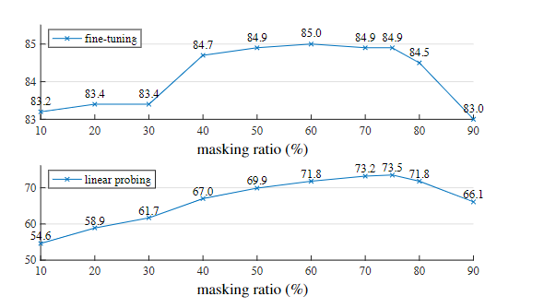
ImageNet Experiments
ViT-Large.
ImageNet-1K
224×224
1.End-to-end
2.Linear Probe
Masking ratio
Best:75%
higher than other in computer vision (20% to 50%).
NTUST GAMELab
Notes:
big improvement
75%

Slide 16
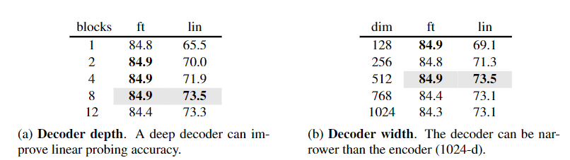
ImageNet Experiments - decoder
8% improvement in linear probing.
Single-block decoder can perform strongly with fine-tuning (84.8%)
Default MAE decoder with 8 blocks and a width of 512-d, only has 9% FLOPs per token vs. ViT-L.
NTUST GAMELab
Notes:
Autoencoder最後幾層對於重建尤為重要
8% improvement in linear probing
less influential for improving fine-tuning
Interestingly, our MAE with a single-block decoder can perform strongly with fine-tuning
a small decoder can further speed up training

Slide 17
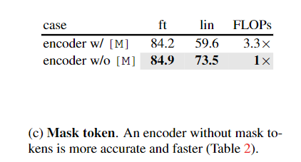
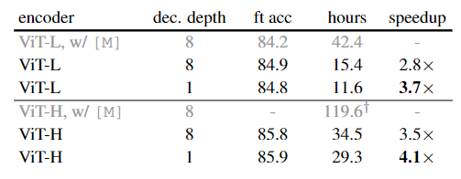
ImageNet Experiments - Mask token
NTUST GAMELab
Notes:
drops by 14% in linear probing
FLOPs by 3.3× 2.8×wall-clock speedup
bigger (3.5–4.1×), for a smaller decoder (1-block)

Slide 18
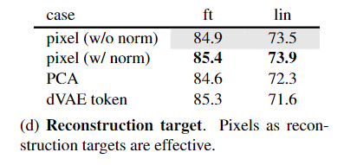
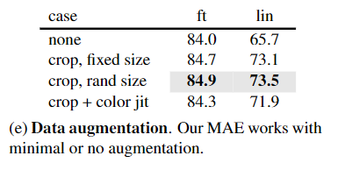
ImageNet Experiment
BEiT
NTUST GAMELab
Notes:
E MAE對於數據增強不會太敏感

Slide 19
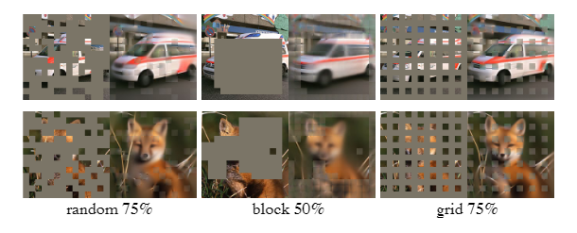
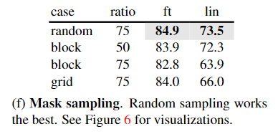
ImageNet Experiments
NTUST GAMELab
Notes:
最簡單的效果是最好的

Slide 20
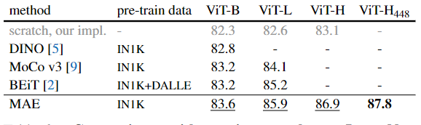
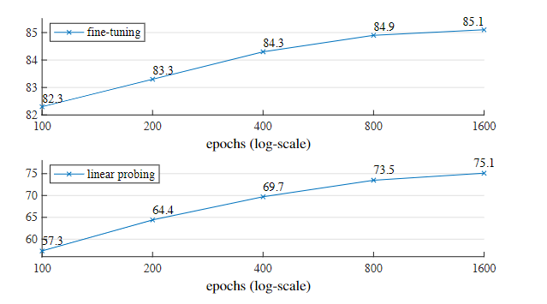
ImageNet Experiments
NTUST GAMELab
Notes:
86.9% VitH 87.8%
Comparing with BEiT MAE is more accurate while being simpler and faster
MAE’s training time is 31 hours for 1600 epochs and
MoCo v3’s is 36 hours for 300 epoch

Slide 21
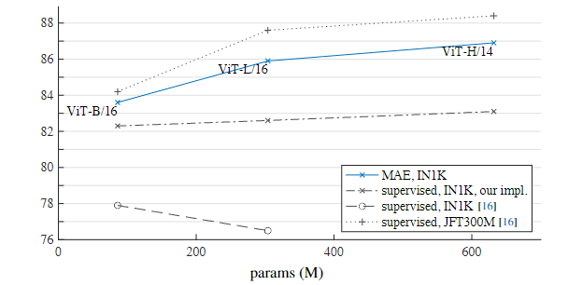
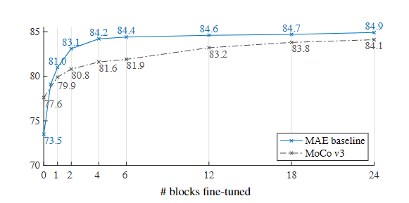
ImageNet Experiments
NTUST GAMELab
Notes:
1.自己模型比較
2.微調幾層網路

Slide 22
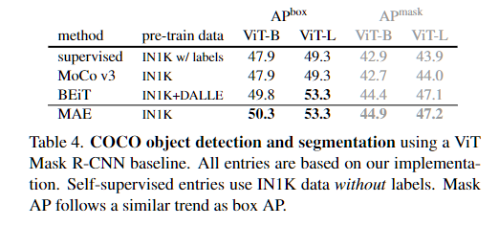
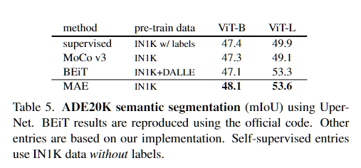
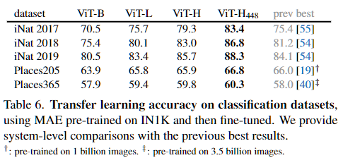
Transfer Learning Experiments
NTUST GAMELab

Slide 23
Discussion and Conclusion
Simple algorithms that scale well are the core of deep learning.
Images and languages are signals of a different nature.
NTUST GAMELab
Notes:
1.簡單可拓展的算法可做為深度學習的核心
2.須注意圖像與語言的區別

Slide 24
報告完畢 THE END
謝謝 Thank You
NTUST GAMELab

Slide 25
Masked Autoencoders
領域
NLP
CV
自學習方法
BERT
MAE
模型
Transformer
ViT
NTUST GAMELab

Slide 26
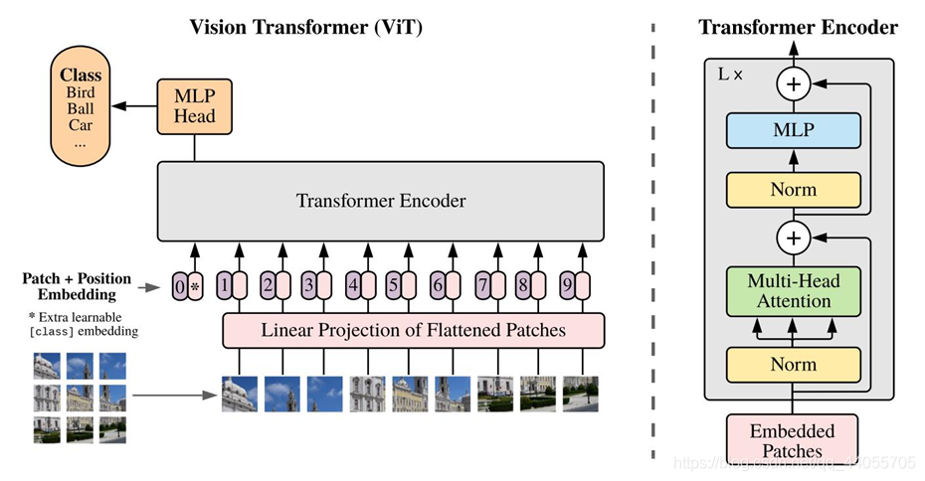
NTUST GAMELab
Notes:
non-hierarchical
如何將Vit結合FPN

